Slide 1
Spring 2017 data analysis

Slide 2
Research Question
What are the joint effects of performance and solution transparency on the innovation outcome?

Slide 3
Hypotheses [ this is to be improved based on theory ]
Full transparency has the highest innovation performance compared to all 3 of the other treatment groups
Full transparency has the highest effort compared to all 3 of the other treatment groups
Full transparency has a higher total score of the apps being clicked across all phases compared to solution transparency
Full transparency has a higher number of clicks assigned to an app compared to solution transparency
Full transparency has a higher number of clicks done by a person compared to solution transparency

Slide 4
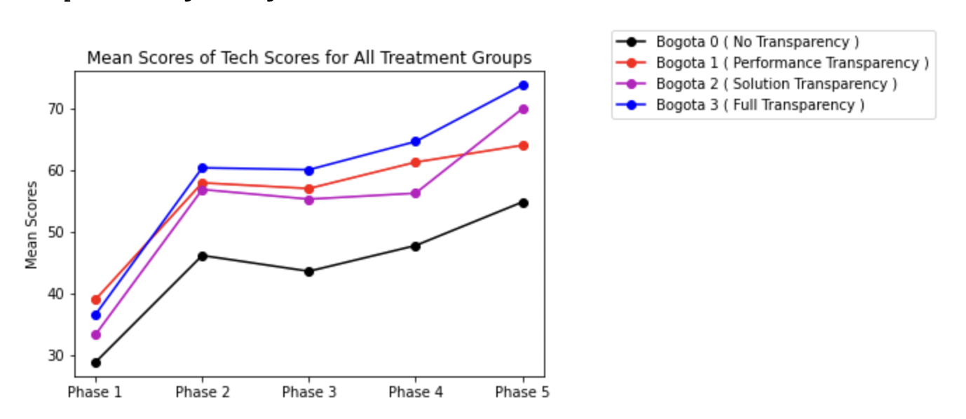
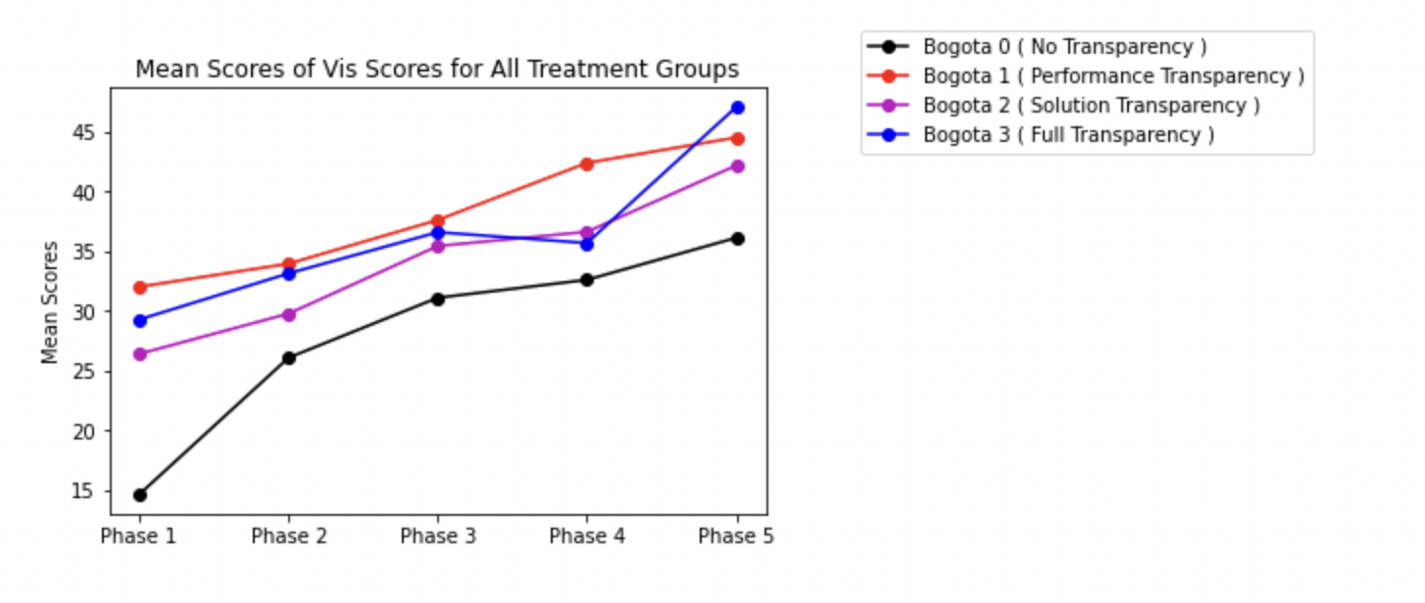
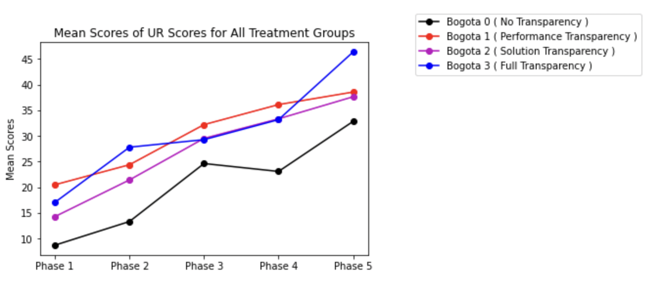
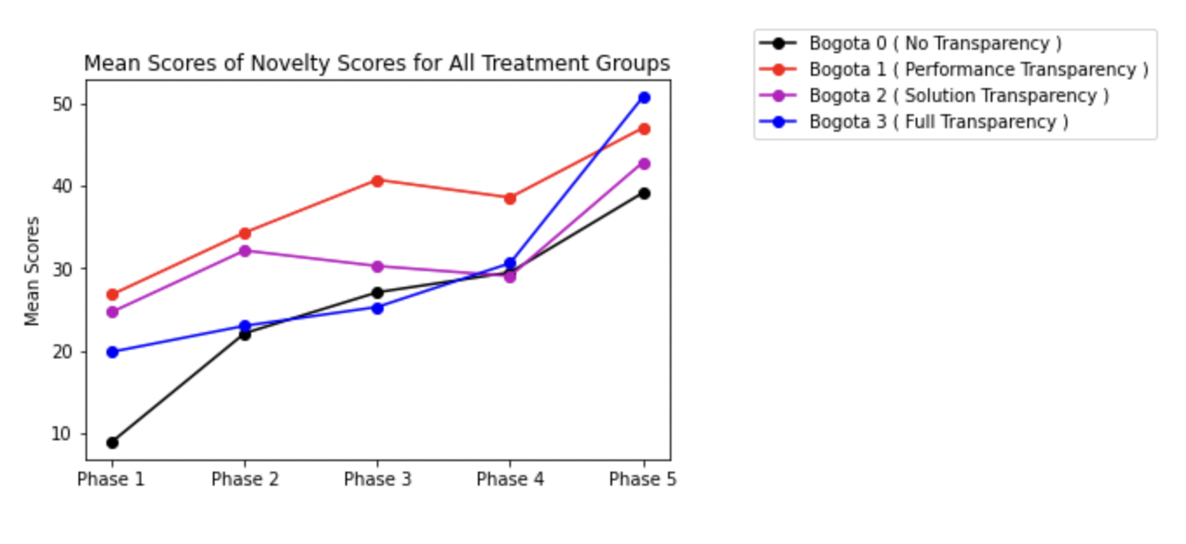
Line Plot of scores in 4 dimensions
Ref Link to Notebook - https://github.com/ironhacks/analysis-2017/blob/main/spring-2017/script/analysis/BoxPlots-LineCharts-BarCharts(Scores%2CLOC%2CD3%2CSurvey).ipynb

Slide 5
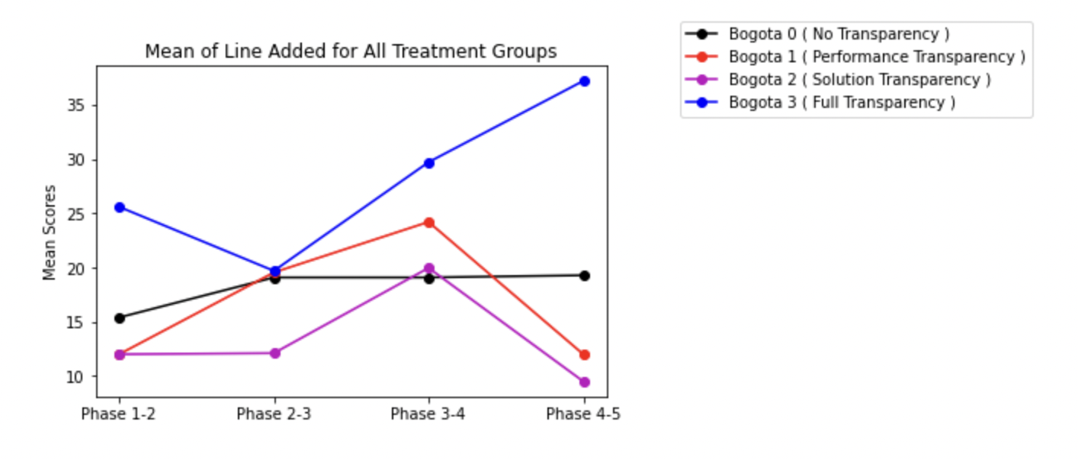
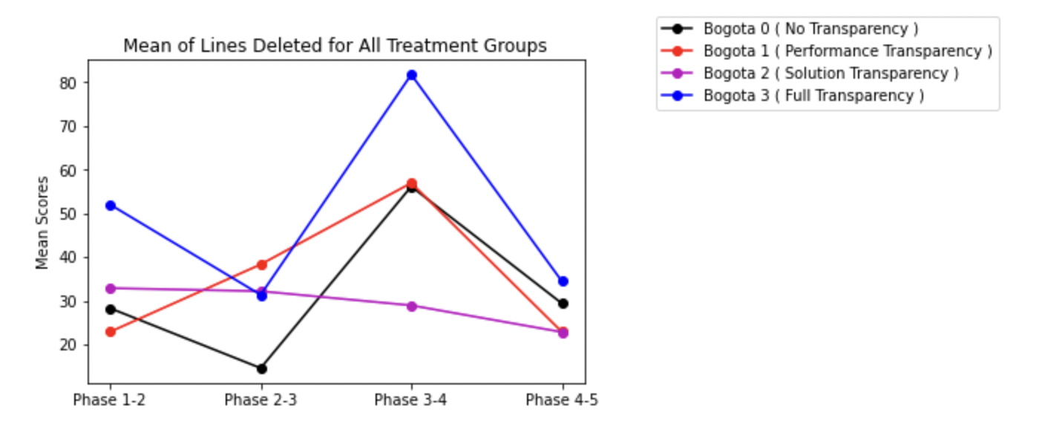
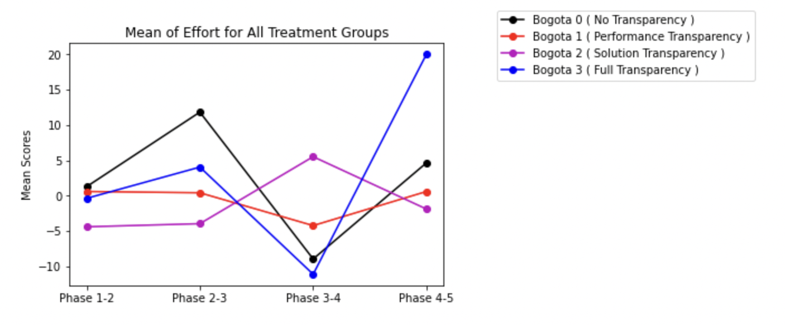
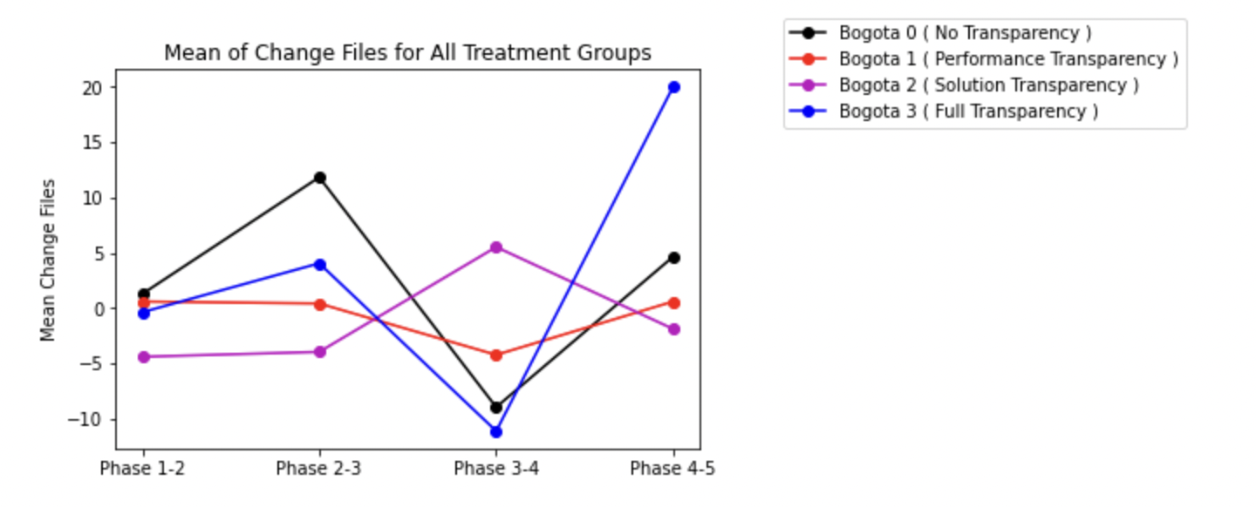
Lines added/deleted/effort/files change
Ref Link to Notebook - https://github.com/ironhacks/analysis-2017/blob/main/spring-2017/script/analysis/BoxPlots-LineCharts-BarCharts(Scores%2CLOC%2CD3%2CSurvey).ipynb

Slide 6
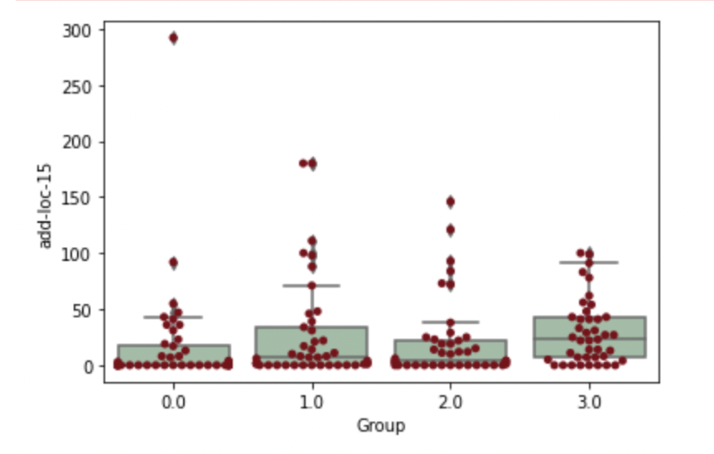
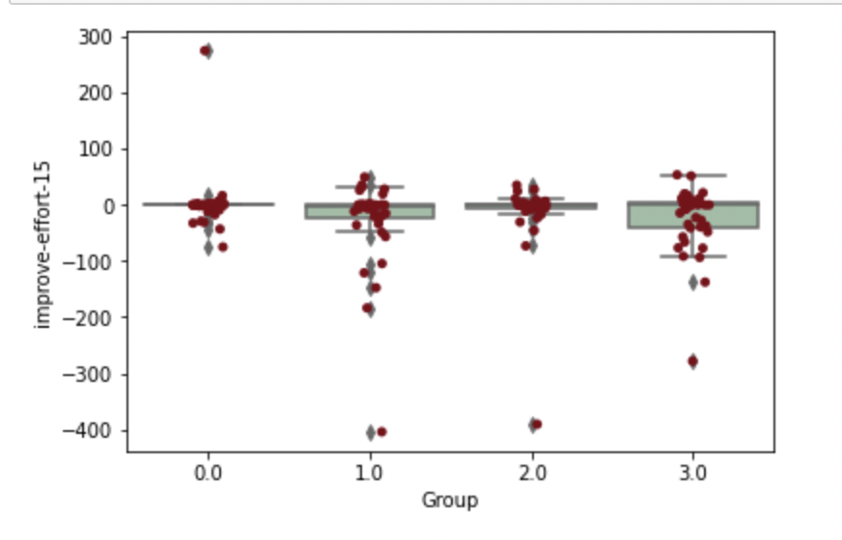
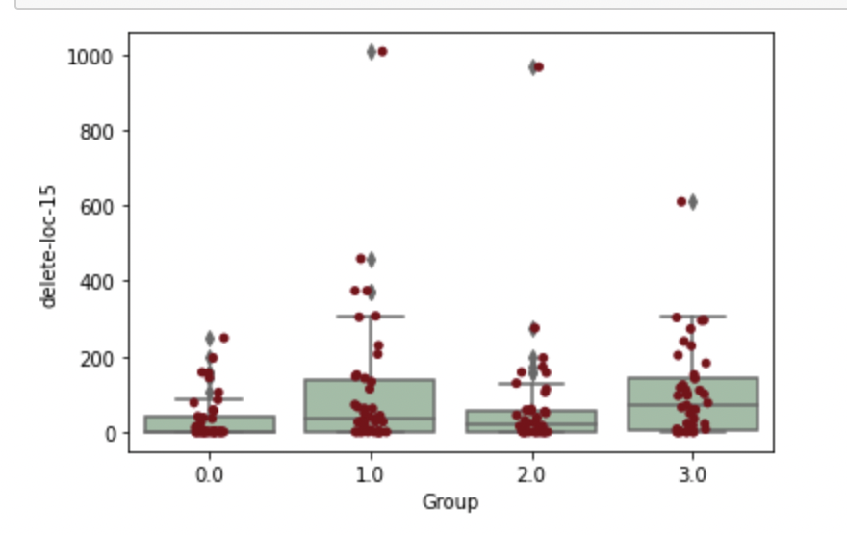
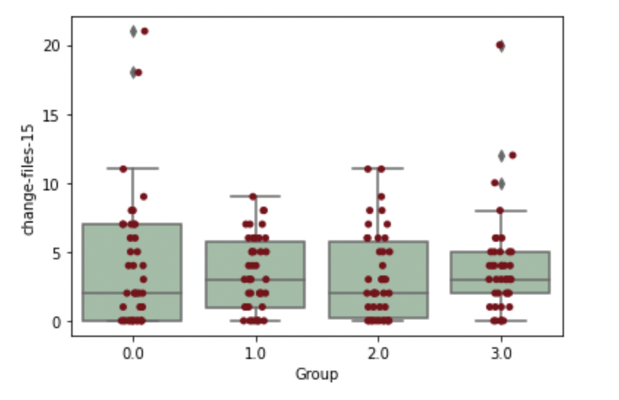
Median Lines added/deleted/effort/files change

Slide 7
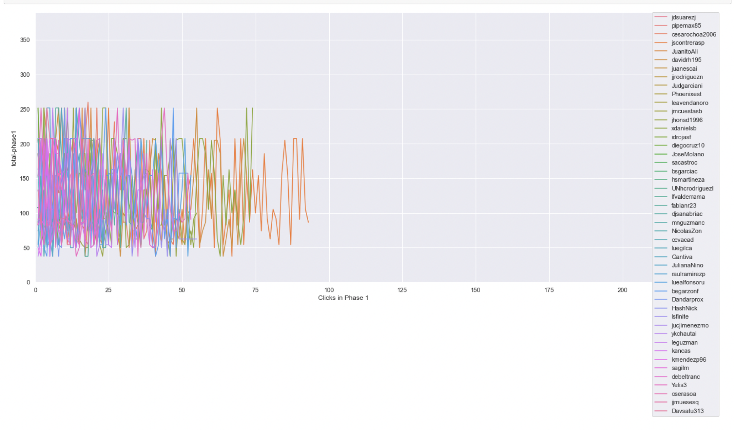
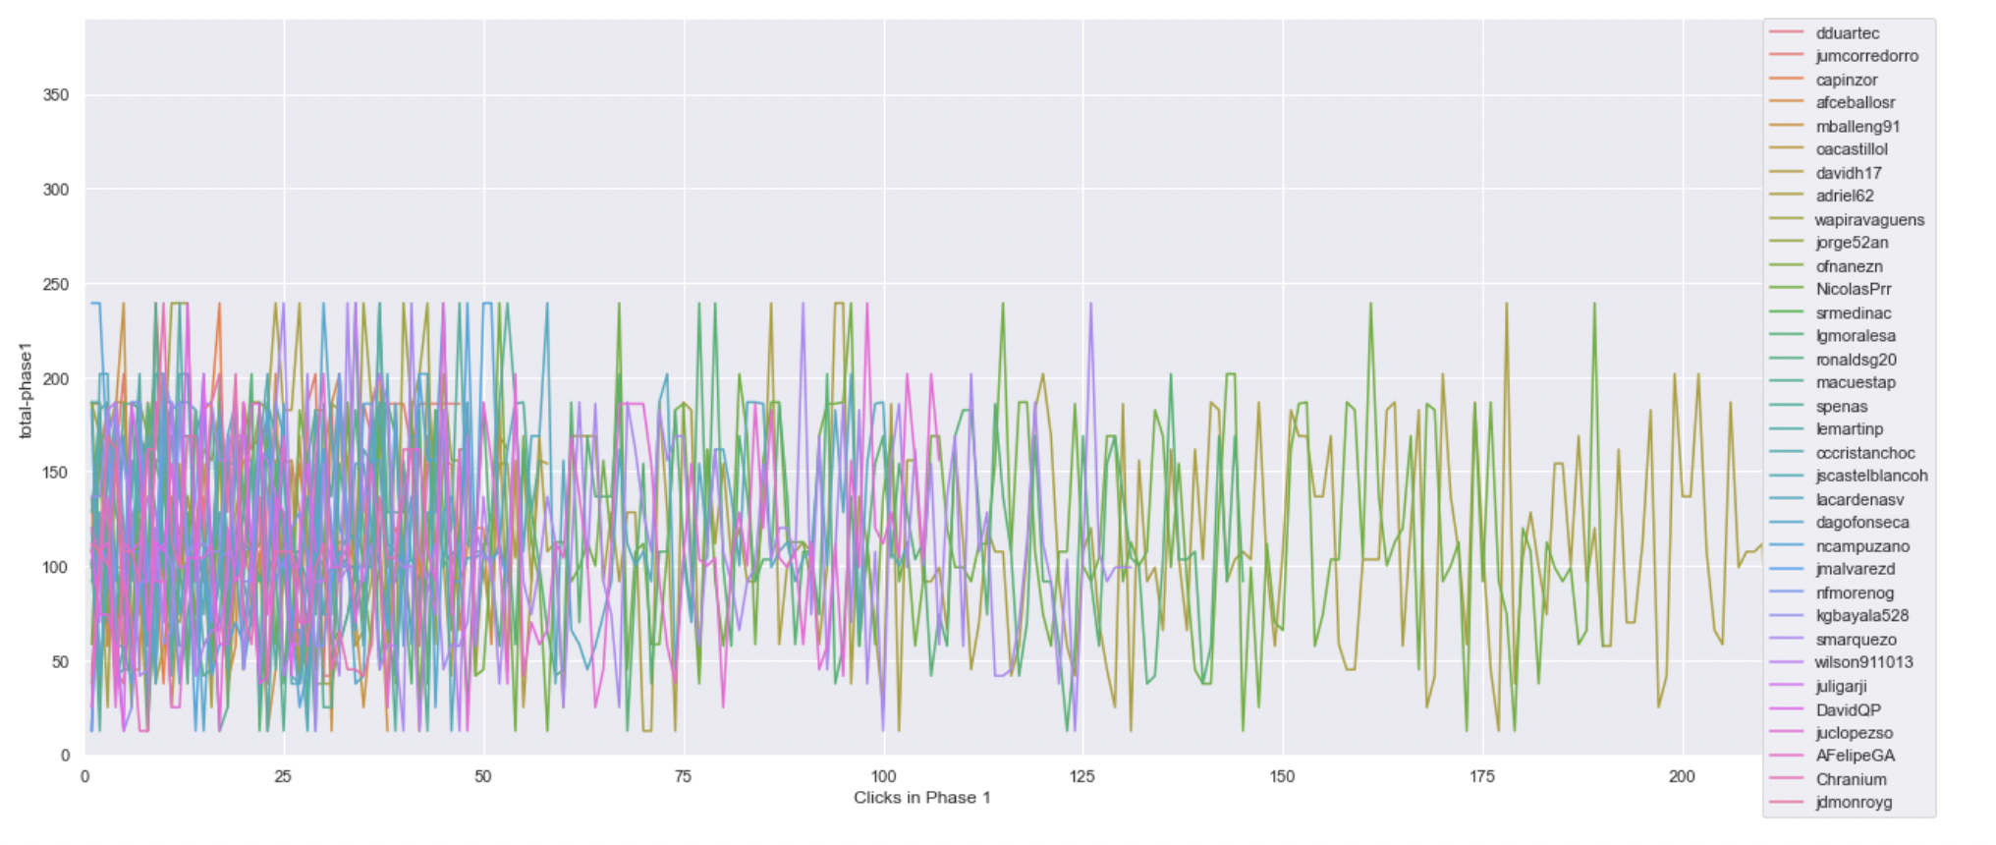
Timeline plot of scores of projects clicked on in phase 1 ( same scale )
Ref Link - https://github.com/ironhacks/analysis-2017/blob/main/spring-2017/script/analysis/Clicks-Analysis(Graphs%2CDescriptive-Analysis).ipynb
Bogota 2 ( Solution Transparency Only ) | Bogota 3 ( Full Transparency )

Slide 8
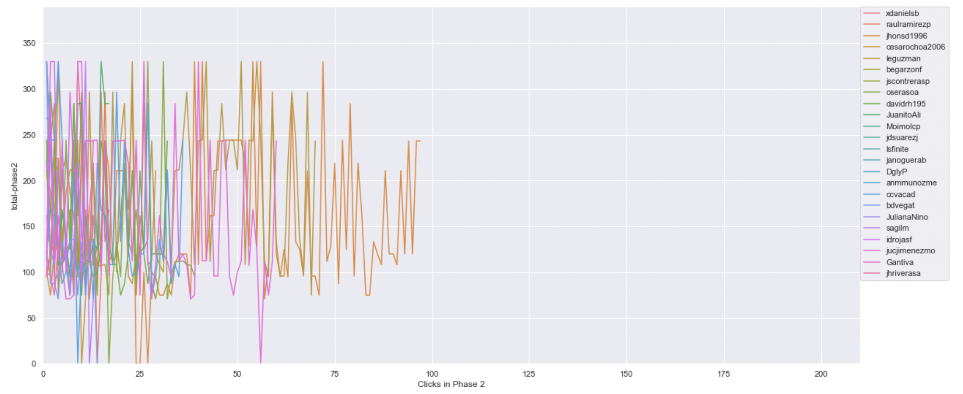
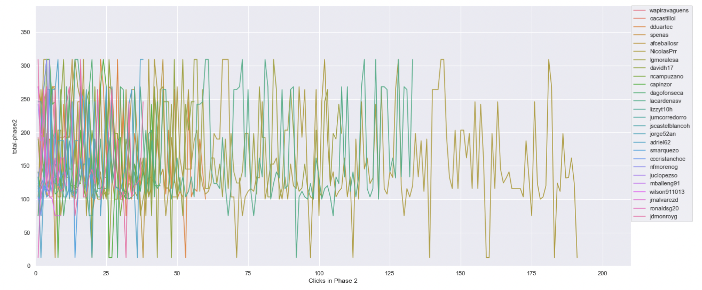
Timeline plot of scores of projects clicked on in phase 2 ( same scale )
Ref Link - https://github.com/ironhacks/analysis-2017/blob/main/spring-2017/script/analysis/Clicks-Analysis(Graphs%2CDescriptive-Analysis).ipynb
Bogota 2 ( Solution Transparency Only ) | Bogota 3 ( Full Transparency )

Slide 9
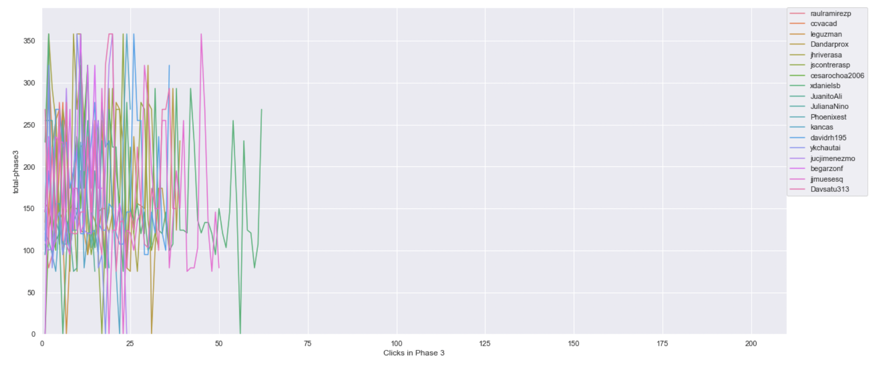
Timeline plot of scores of projects clicked on in phase 3 ( same scale )
Ref Link - https://github.com/ironhacks/analysis-2017/blob/main/spring-2017/script/analysis/Clicks-Analysis(Graphs%2CDescriptive-Analysis).ipynb
Bogota 2 ( Solution Transparency Only ) | Bogota 3 ( Full Transparency )

Slide 10
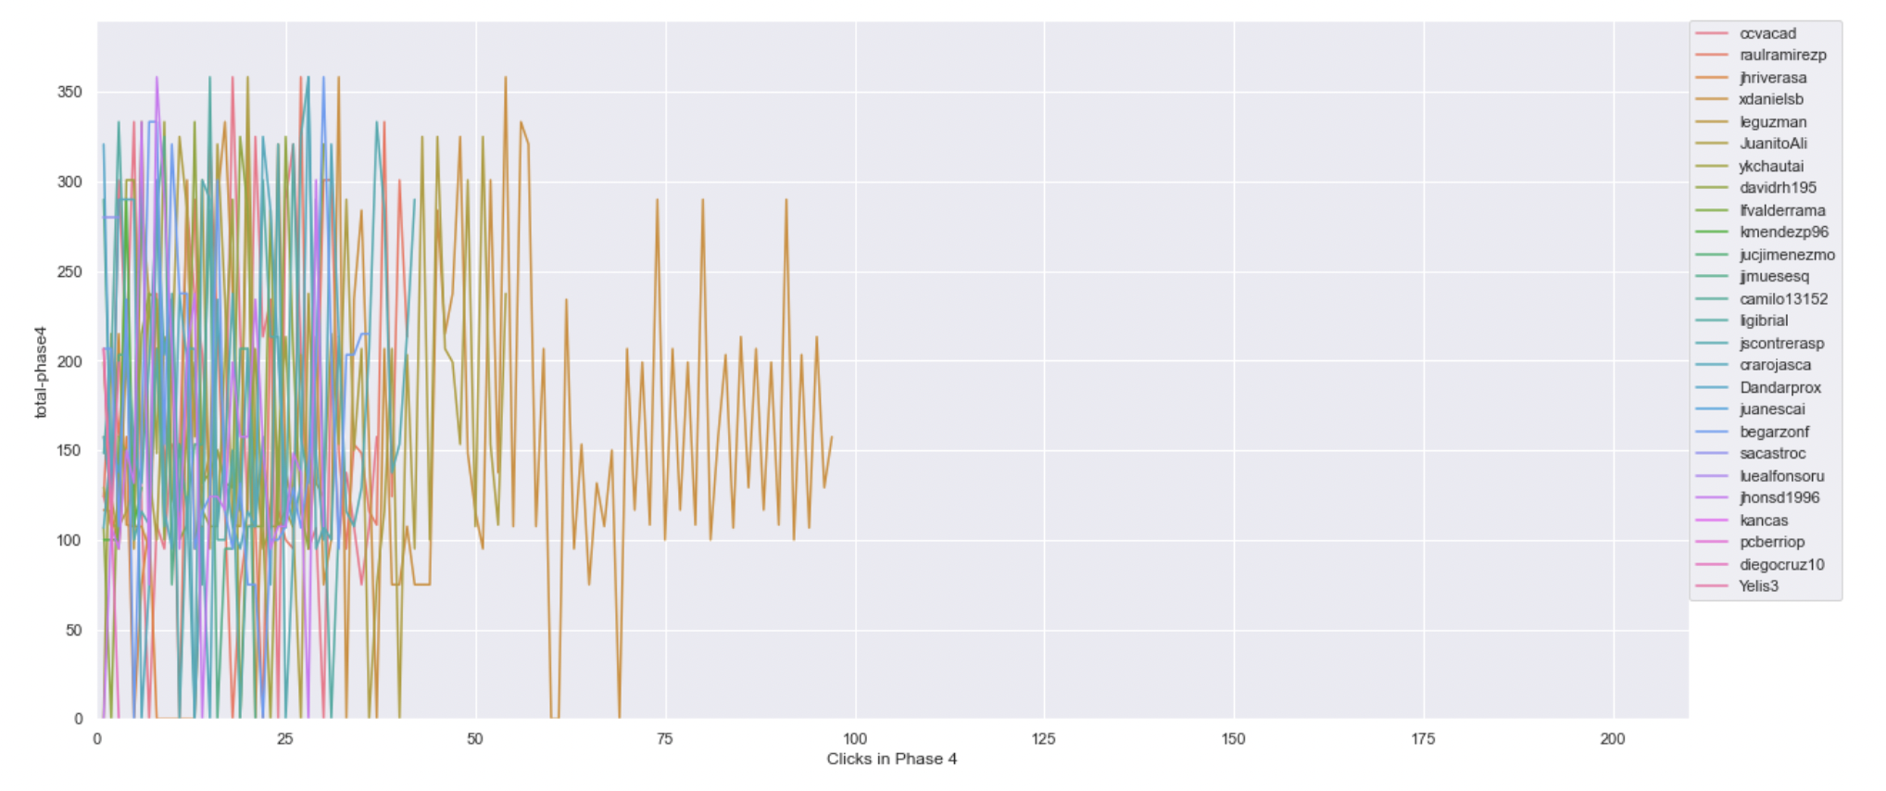
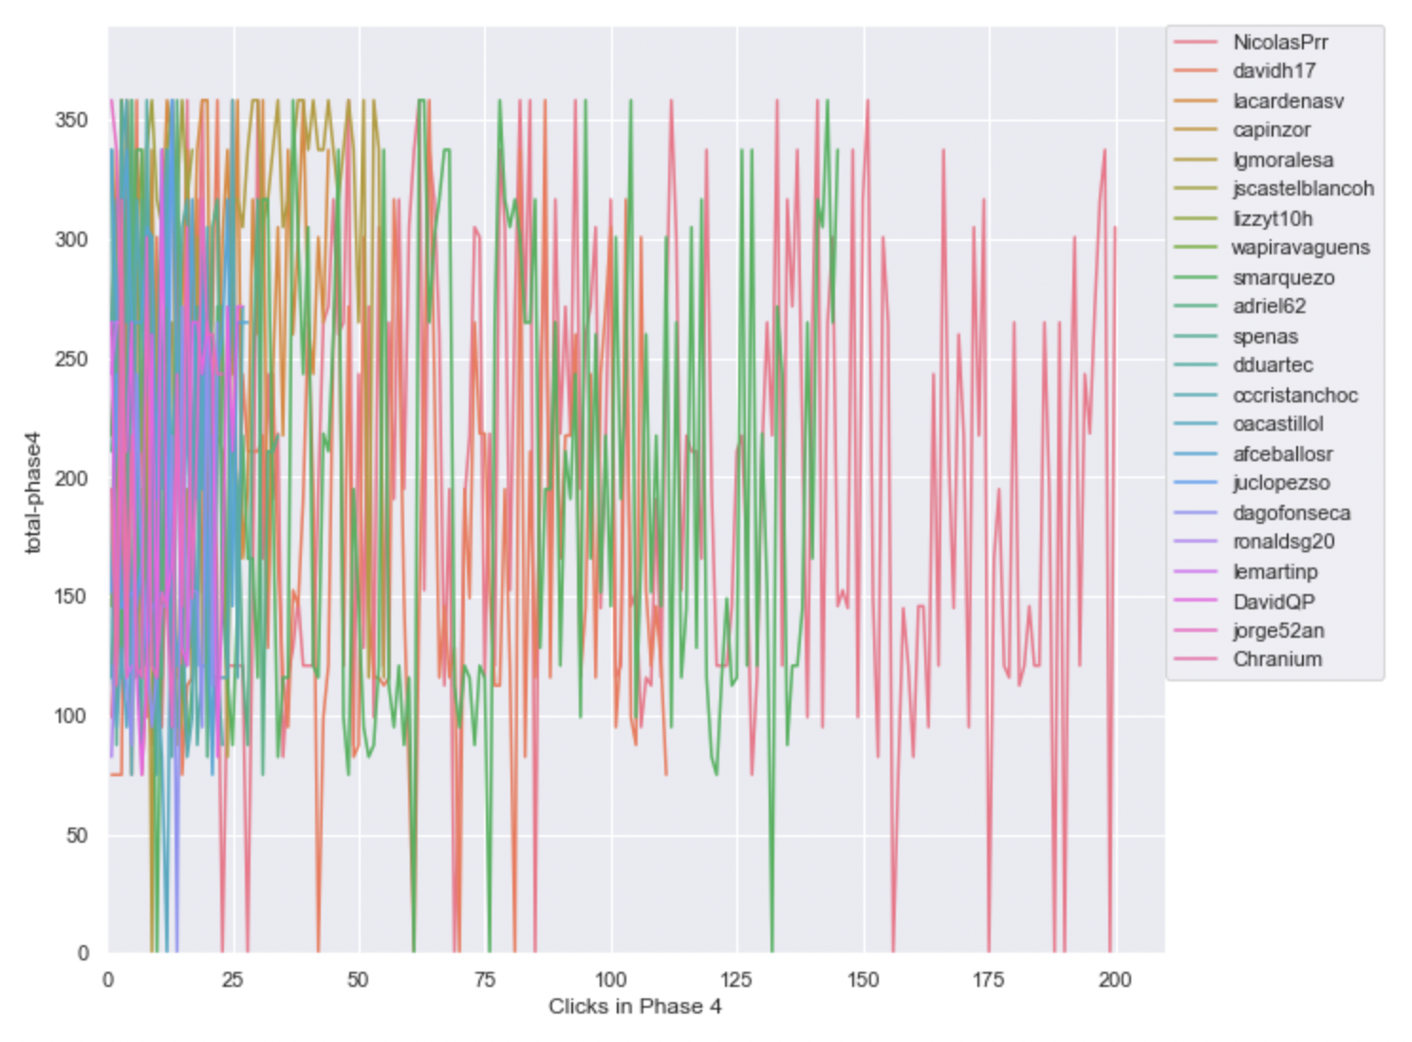
Timeline plot of scores of projects clicked on in phase 4 ( same scale )
Ref Link - https://github.com/ironhacks/analysis-2017/blob/main/spring-2017/script/analysis/Clicks-Analysis(Graphs%2CDescriptive-Analysis).ipynb
Bogota 2 ( Solution Transparency Only ) | Bogota 3 ( Full Transparency )

Slide 11
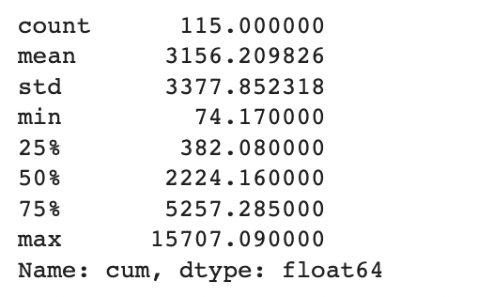
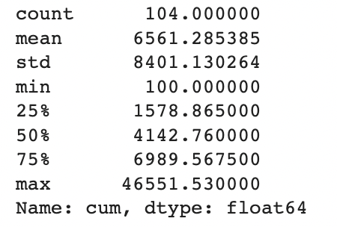
Total Score of the Apps Being Clicked Across All Phases ( Descriptive Analysis )
Ref Link - https://github.com/ironhacks/analysis-2017/blob/main/spring-2017/script/analysis/Clicks-Analysis(Graphs%2CDescriptive-Analysis).ipynb
Bogota 2 ( Solution Transparency ) | Bogota 3 ( Full Transparency )

Slide 12
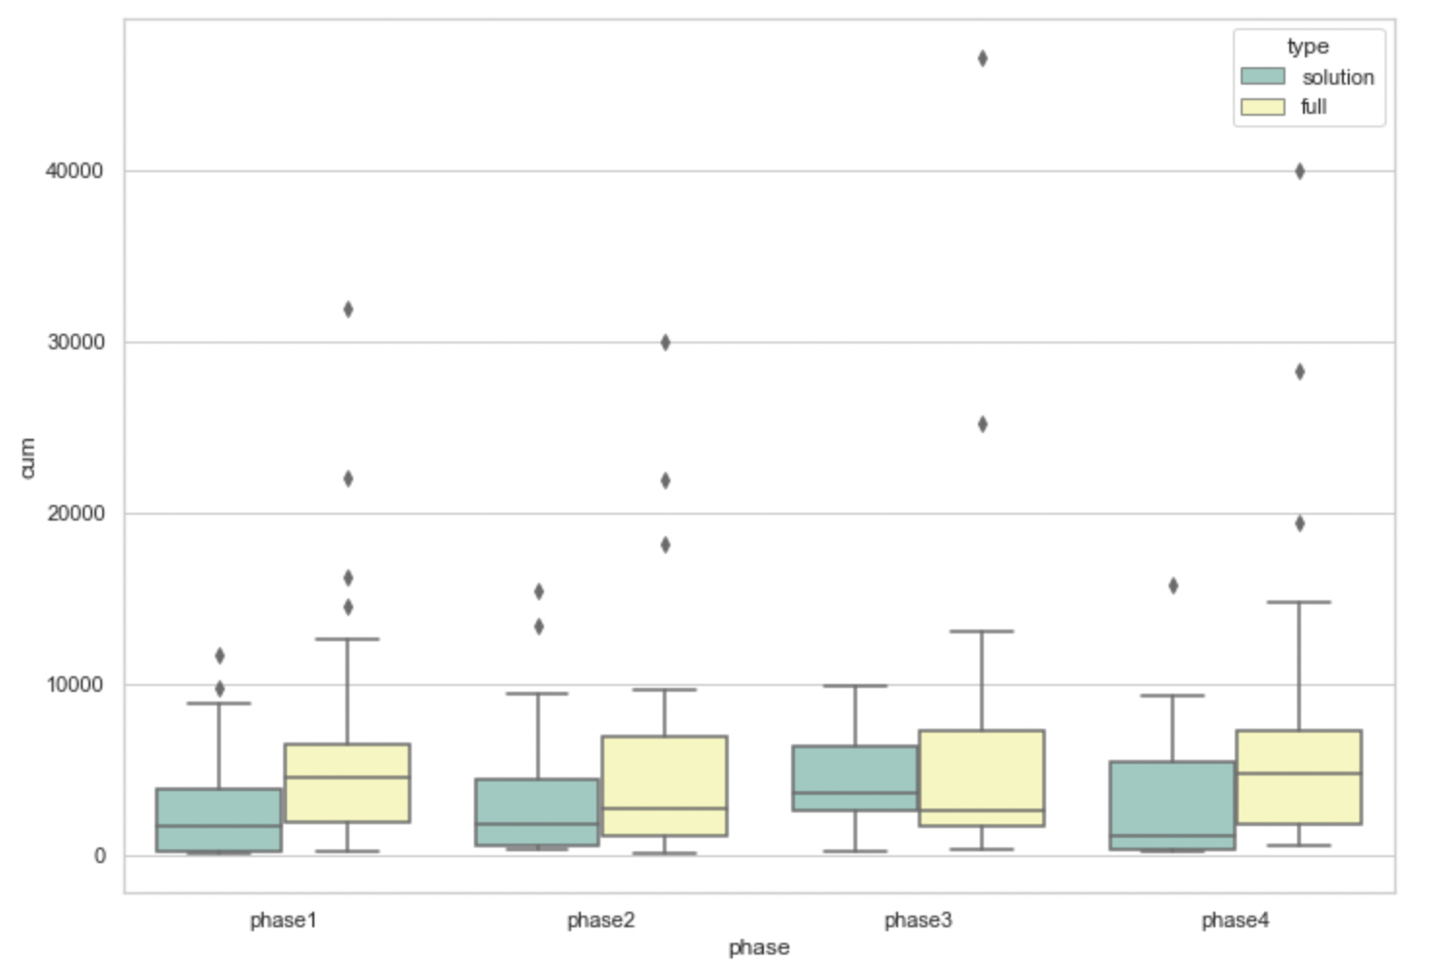
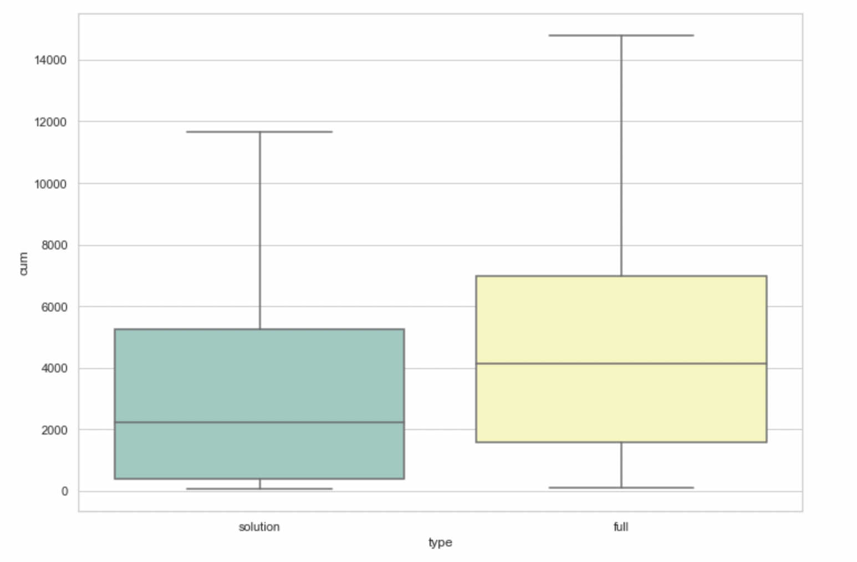
Total Score of the Apps Being Clicked Across All Phases ( box plots )
pvalue=0.00017575311061889564
( Independent T-test )

Slide 13
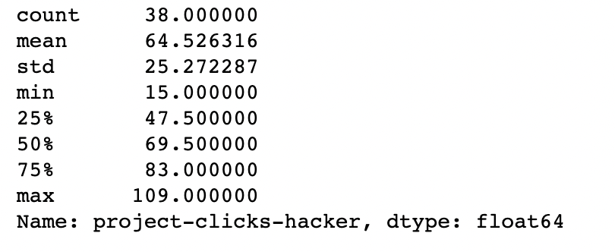
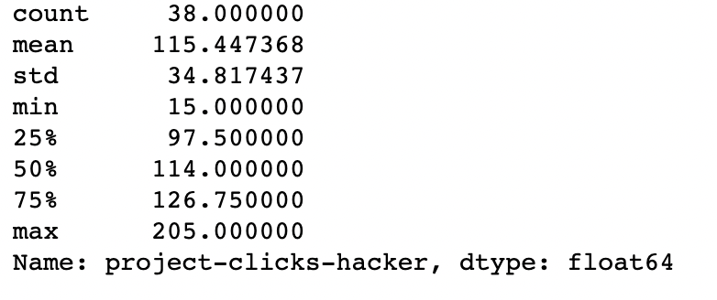
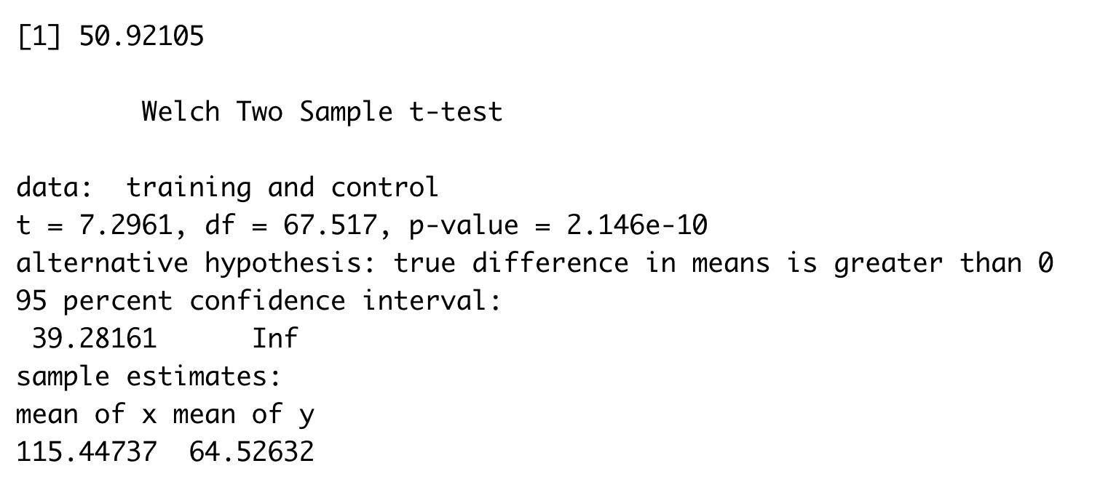
The number of clicks assigned to an app
Bogota 2 ( Solution Transparency ) | Bogota 3 ( Full Transparency )

Slide 14
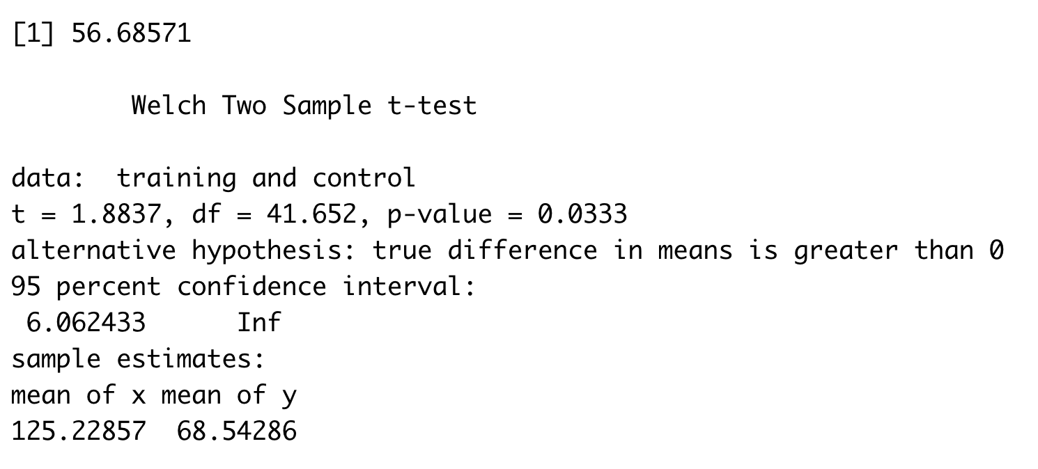
The number of clicks done by a person
Bogota 2 ( Solution Transparency ) | Bogota 3 ( Full Transparency )
Stats for Solution Transparency Min. : 1.00 1st Qu.: 32.00 Median : 55.00 Mean : 68.54 3rd Qu.: 88.00 Max. :250.00 NA's :7 | Stats for Full Transparency Min. : 1.0 1st Qu.: 43.0 Median : 60.0 Mean :125.2 3rd Qu.:128.5 Max. :821.0 NA's :6

Slide 15
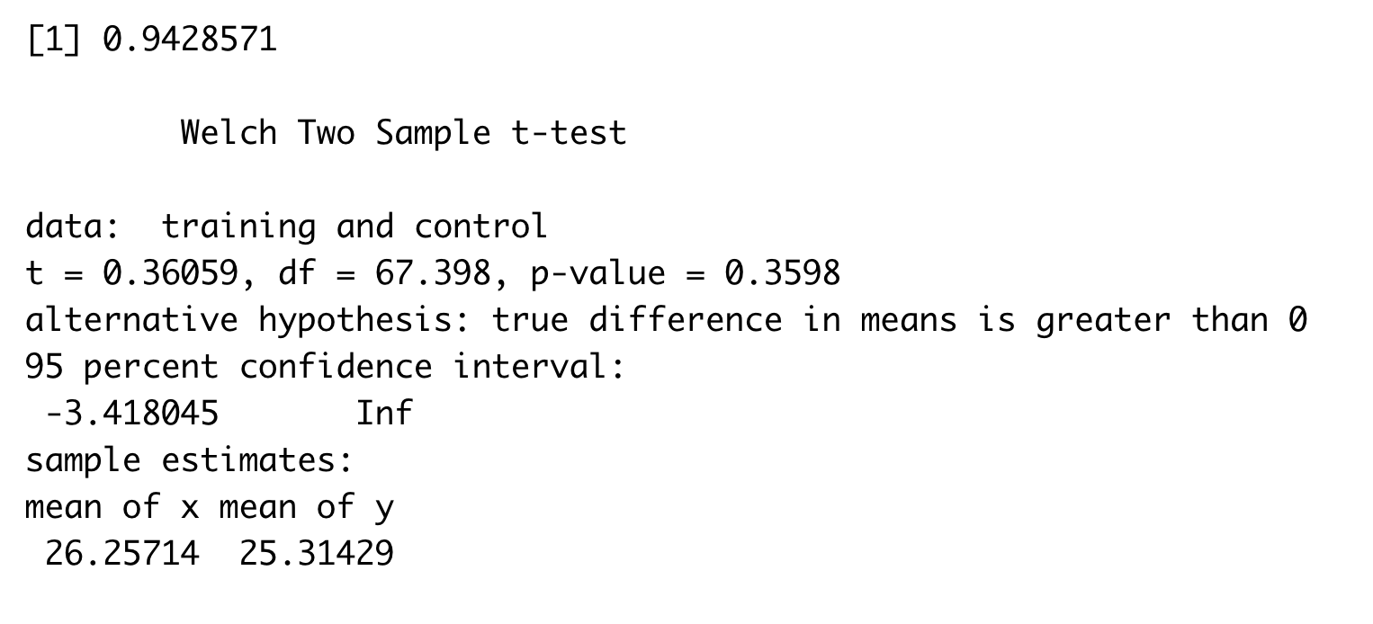
The number of unique apps explored
Bogota 2 ( Solution Transparency ) | Bogota 3 ( Full Transparency )
Stats for Solution Transparency count 35.000000 mean 25.314286 std 10.408626 min 1.000000 25% 20.500000 50% 27.000000 75% 34.500000 max 37.000000 | Stats for Full Transparency count 35.000000 mean 26.257143 std 11.443834 min 1.000000 25% 21.500000 50% 29.000000 75% 36.500000 max 38.000000

Slide 16
Cross stage similarity metrics on an individual level (Variable Name: individual_exploration (IND_EXP))

Slide 17
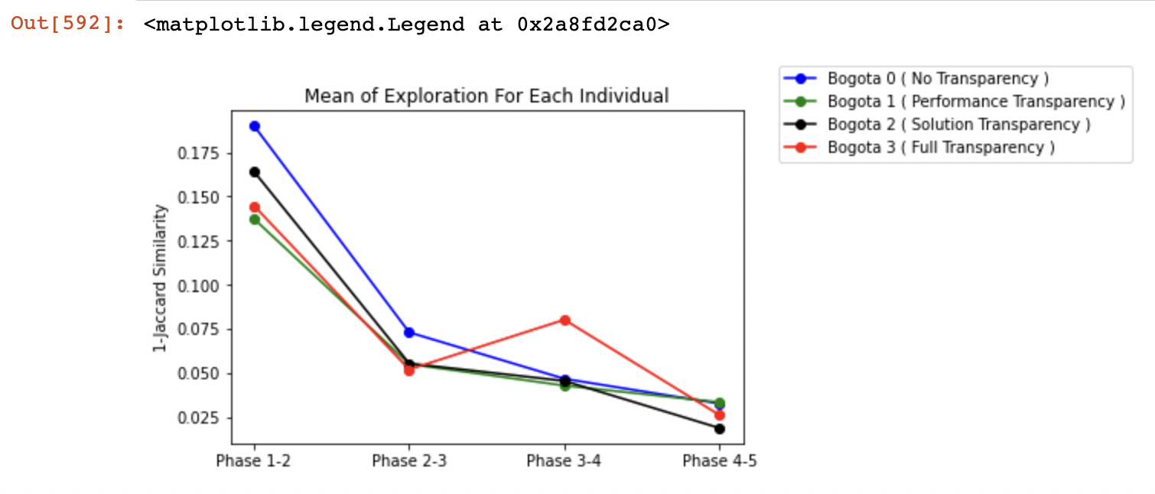
Mean Individual Exploration [ Prior Log-Transform ]

Slide 18
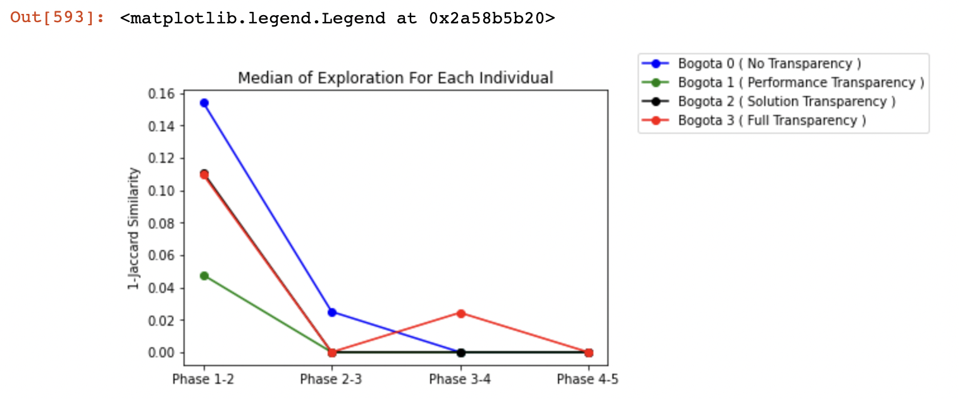
Median Individual Exploration [ Prior Log-Transform ]

Slide 19
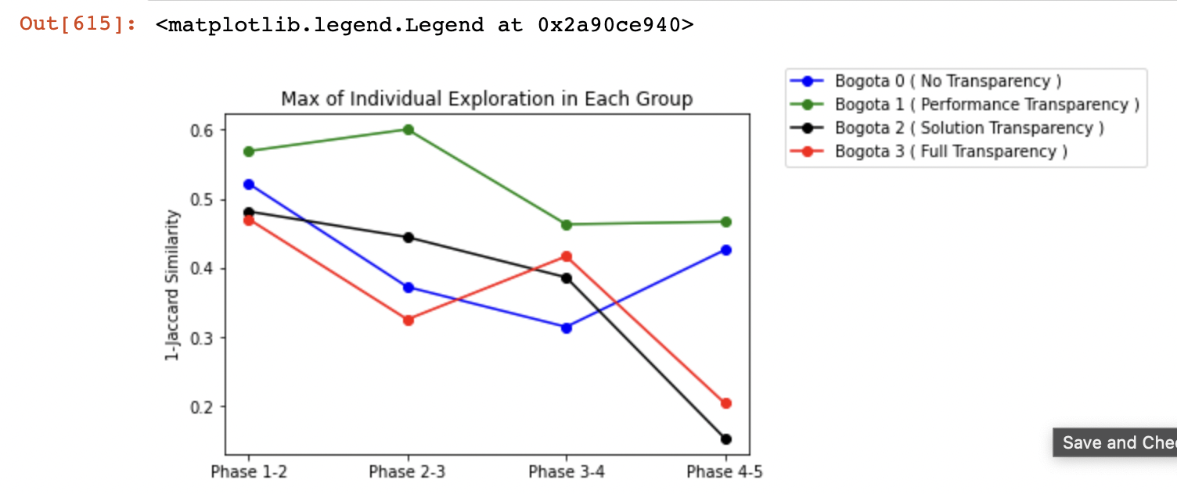
Max Individual Exploration [ Prior Log-Transform ]

Slide 23
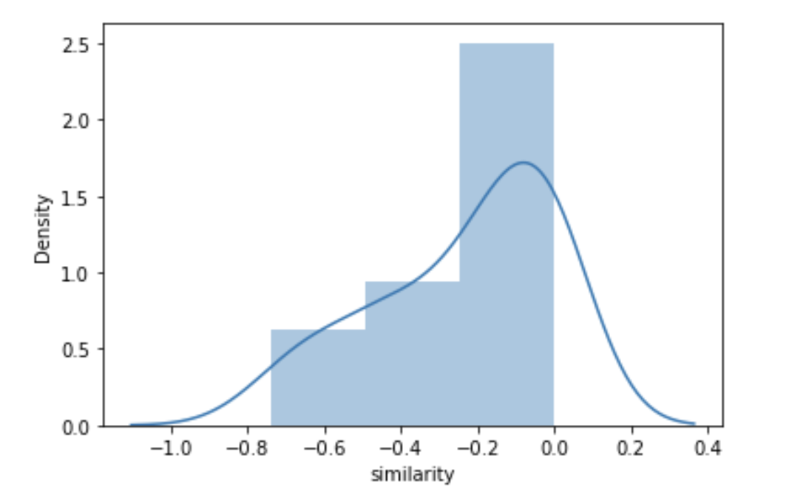
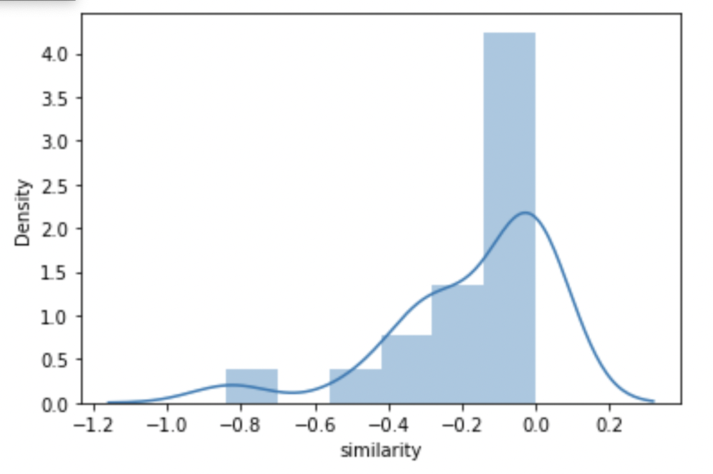
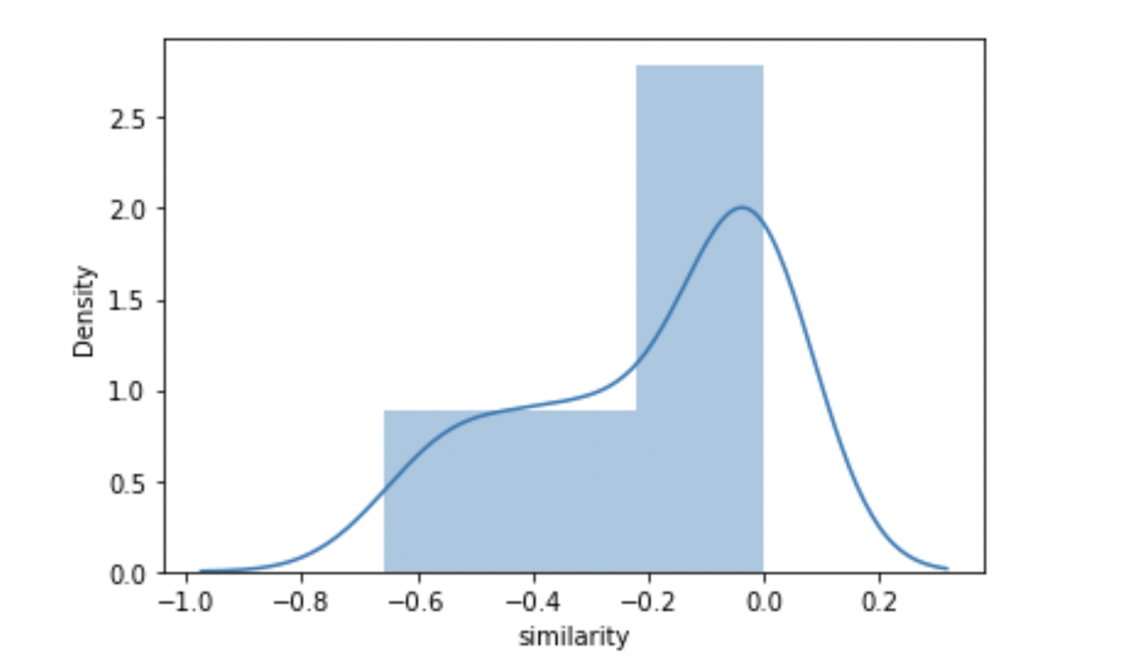
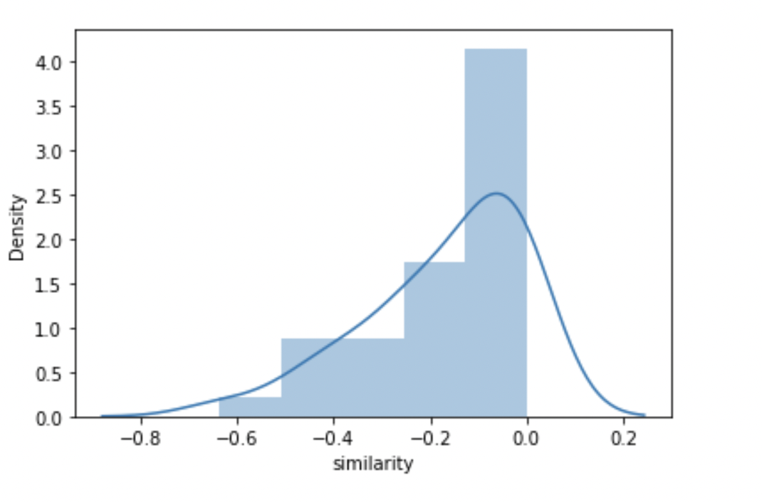
Phase 1-2 After Natural Log Transformation
Bogota 0 | Bogota 1
Bogota 2 | Bogota 3

Slide 24
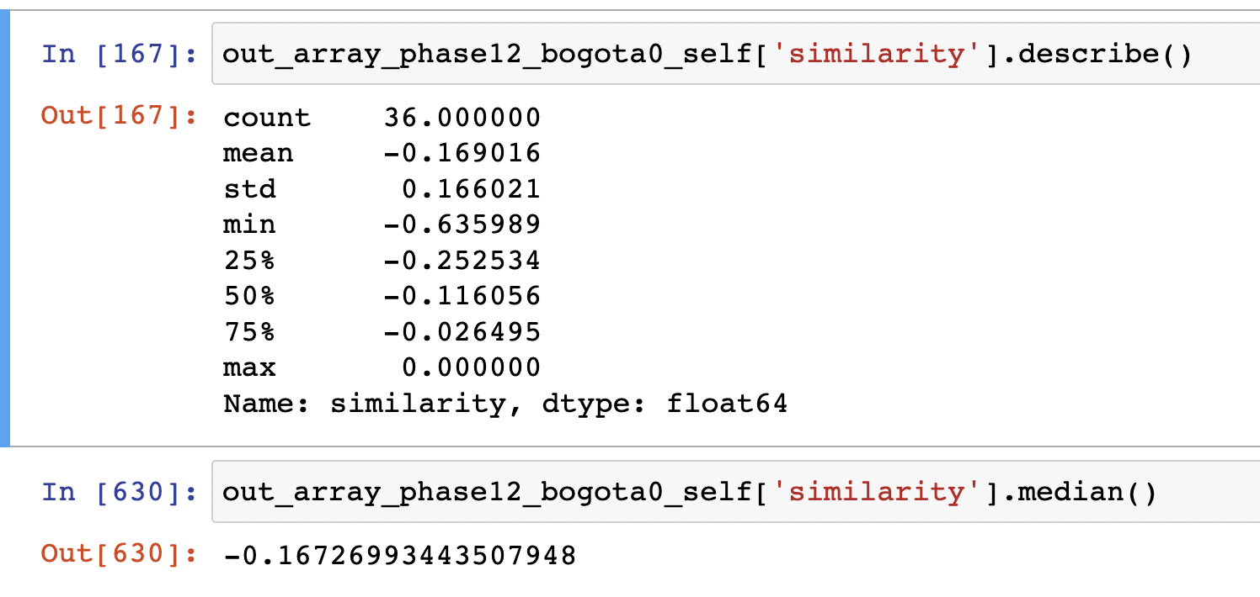
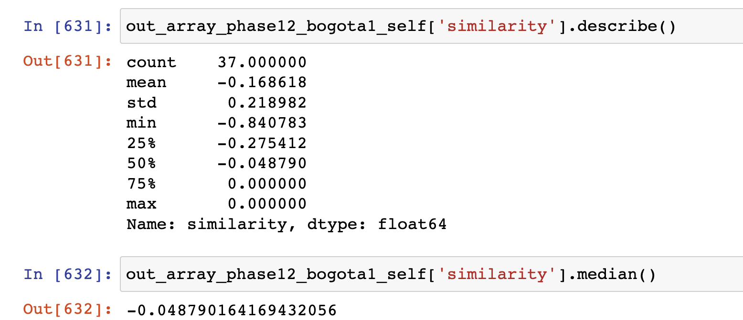
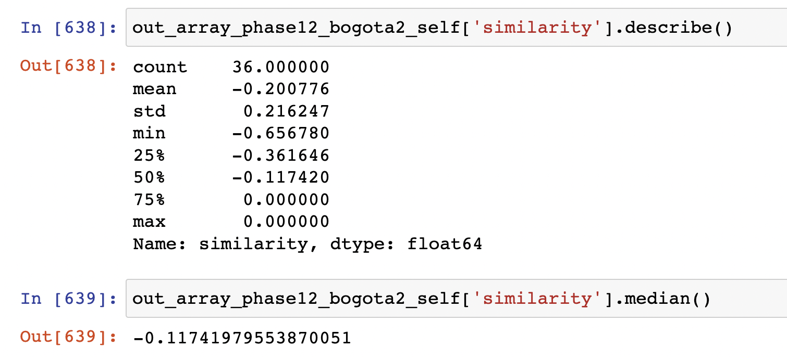
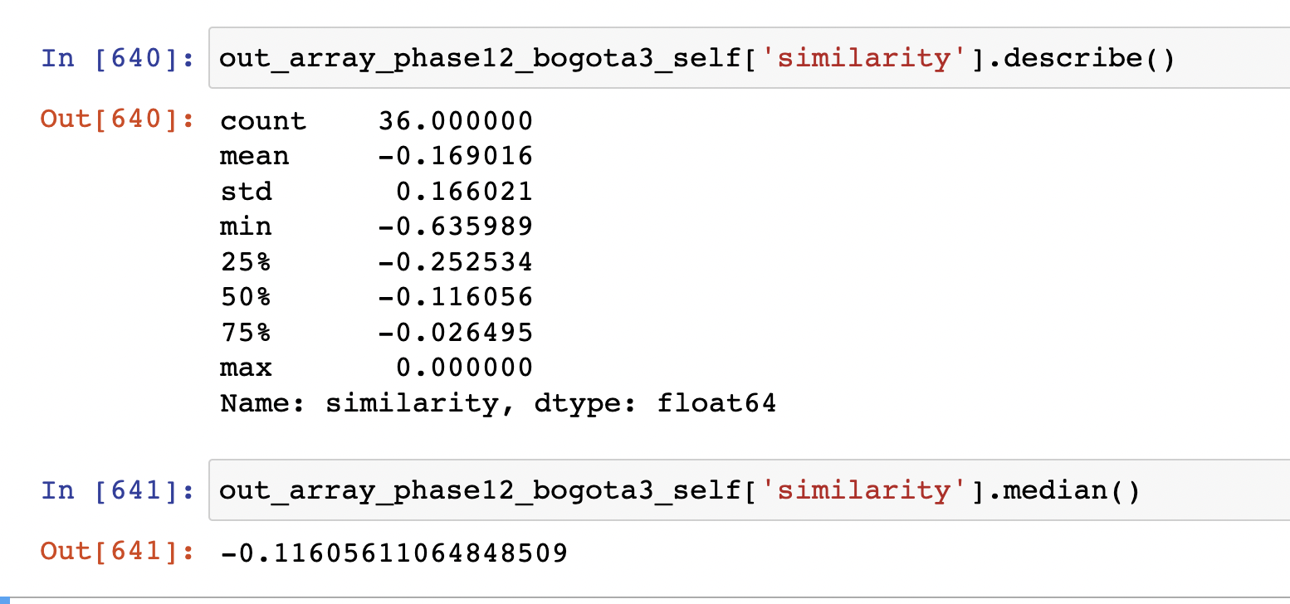
Phase 1-2 After Natural Log Transformation
Bogota 0 | Bogota 1
Bogota 2 | Bogota 3

Slide 25
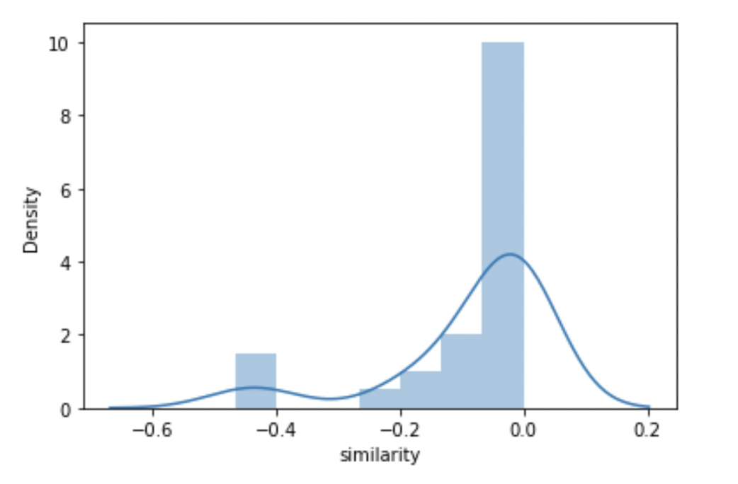
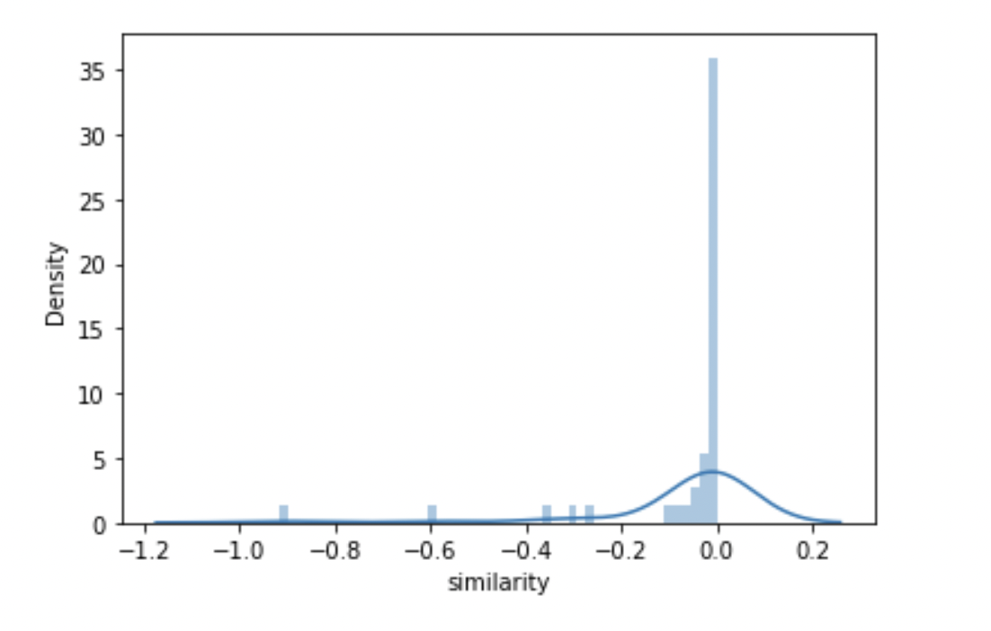
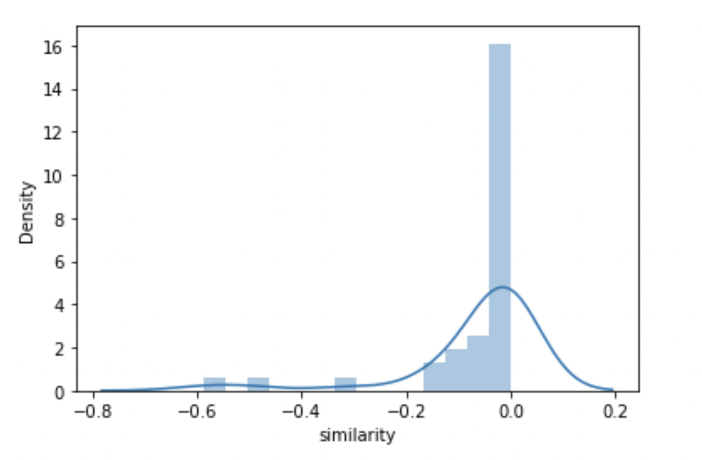
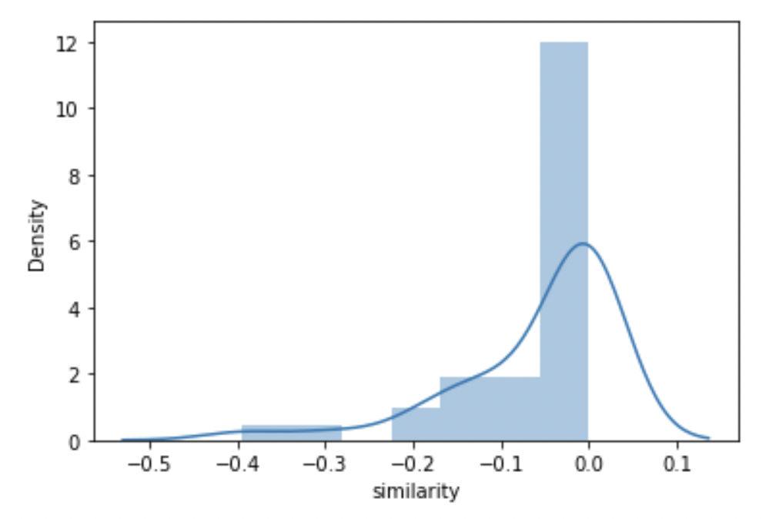
Phase 2-3 After Natural Log Transformation
Bogota 0 | Bogota 1
Bogota 2 | Bogota 3

Slide 26
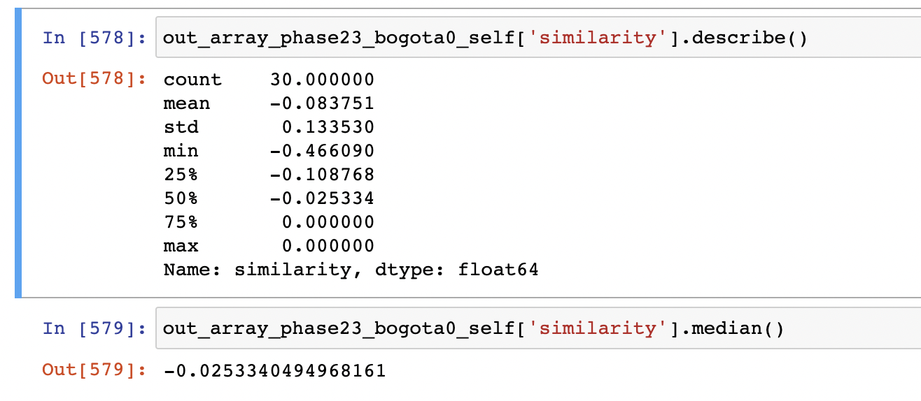
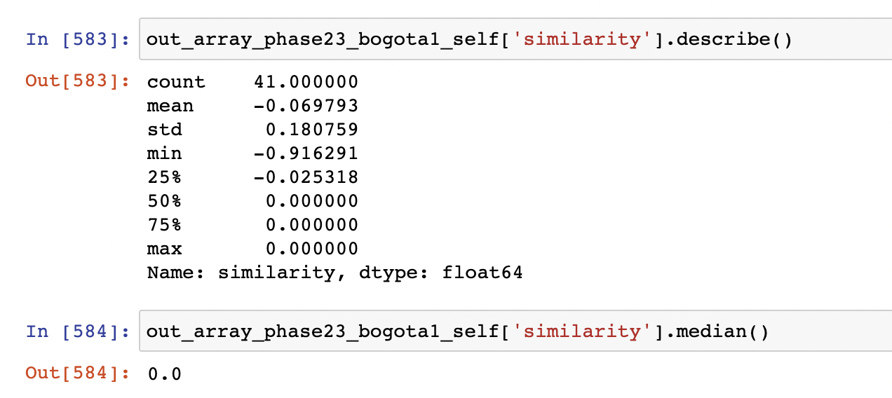
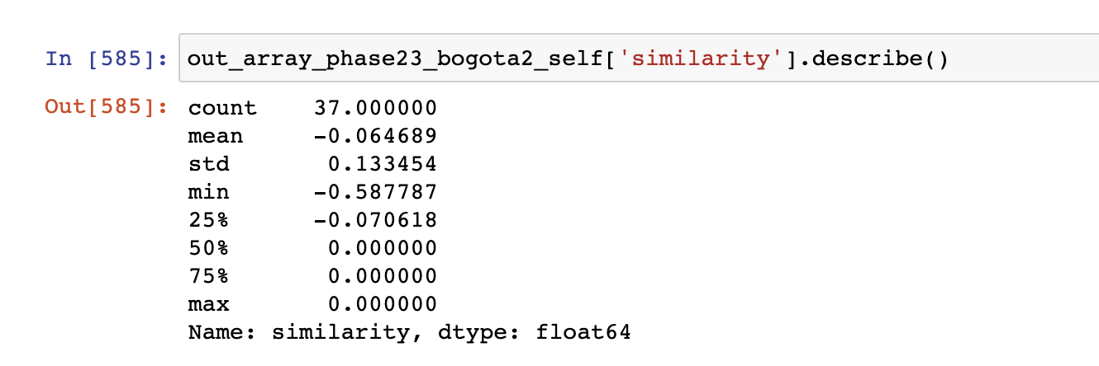
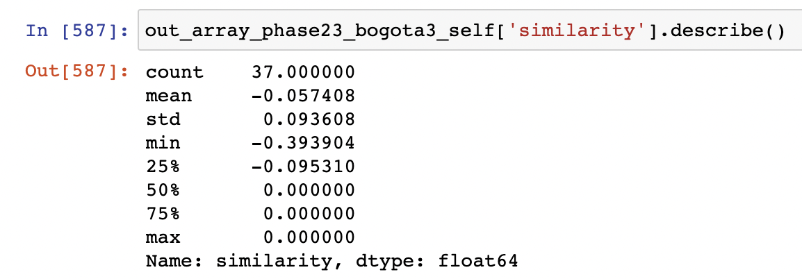
Phase 2-3 After Natural Log Transformation
Bogota 0 | Bogota 1
Bogota 2 | Bogota 3

Slide 27
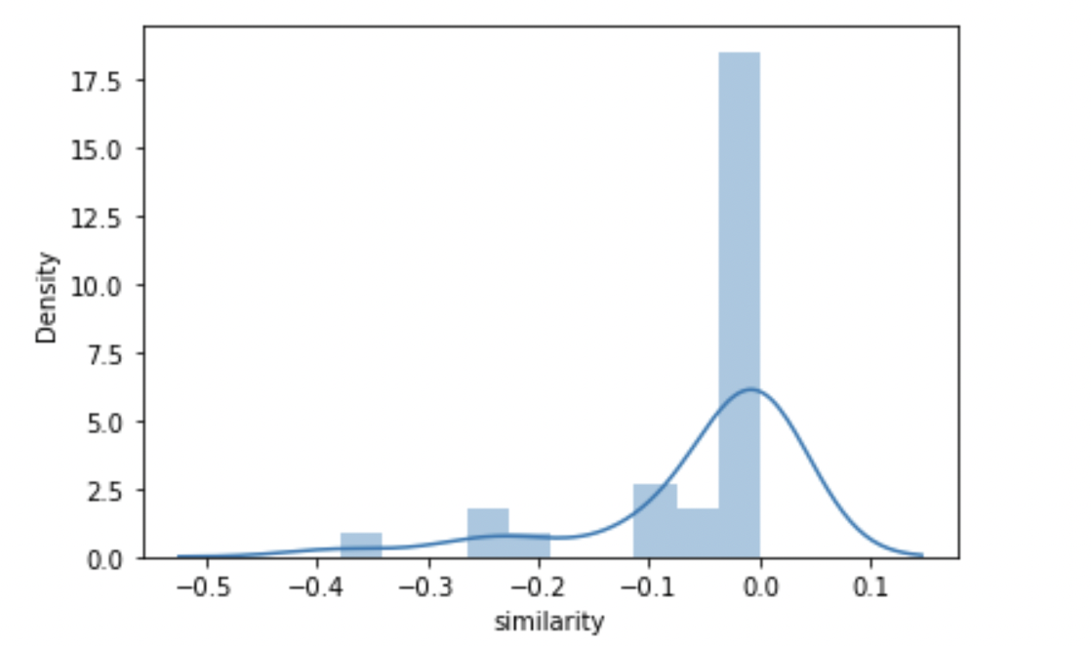
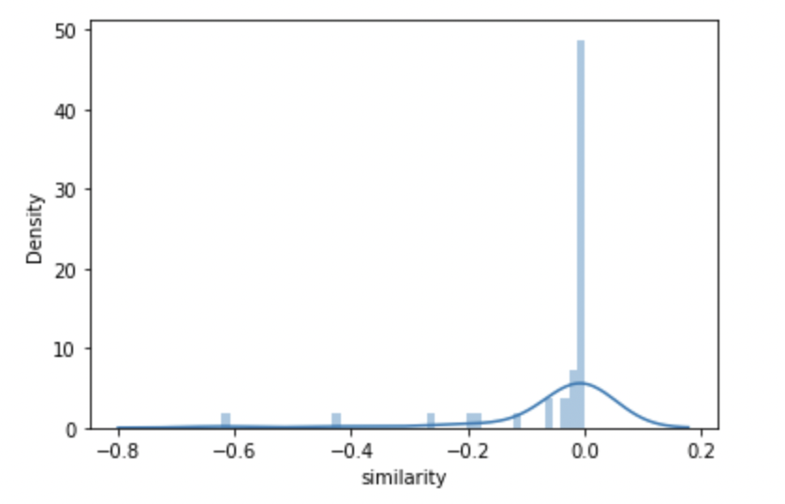
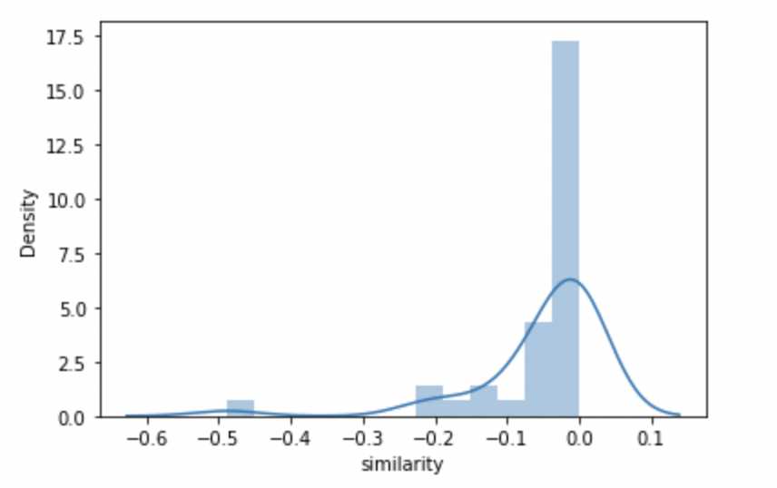

Phase 3-4 After Natural Log Transformation
Bogota 0 | Bogota 1
Bogota 2 | Bogota 3

Slide 28




Phase 3-4 After Natural Log Transformation
Bogota 0 | Bogota 1
Bogota 2 | Bogota 3

Slide 29




Phase 4-5 After Natural Log Transformation
Bogota 0 | Bogota 1
Bogota 2 | Bogota 3

Slide 30




Phase 4-5 After Natural Log Transformation
Bogota 0 | Bogota 1
Bogota 2 | Bogota 3

Slide 31


Total Count of Functions for Each Group

Slide 32


Total Unique Functions for Each Group

Slide 33

Median Count of Template Functions Per Individual

Slide 34

Median Template Similarity

Slide 35

Mean Count of Template Functions Per Individual

Slide 36

Mean Template Similarity

Slide 37


Distribution Plot of Template Functions Per Individual
Phase 1 | Phase 2

Slide 38


Distribution Plot of Template Functions Per Individual

Slide 39

Distribution Plot of Template Functions Per Individual

Slide 40

Median Functions Per Individual [ Variety ] [ Repetition Removed ]

Slide 41




Log Transformed Plot for Unique Functions
Bogota 3 | Bogota 2
Bogota 1 | Bogota 0

Slide 42

Median Rare Functions [ 10% Quantile ] [ Functions Level ]

Slide 43

Median Top 10% Rare Functions Per Individual [ Per Phase ]

Slide 44


Mean/Median Rare Functions [ 10% Quantile ] [ Individual Level ] [ Overall Case ]
Mean
Median

Slide 45


Mean/Median Rare Functions [ 20% Quantile ] [ Individual Level ] [ Overall Case ]

Slide 46

Distribution of Rare Functions [ 10% ] [ Individual Level ] [ Overall Case ]

Slide 47

Distribution of Rare Functions [ 20% ] [ Individual Level ] [ Overall Case ]

Slide 48

Phase 1 Error Bar for 10% Quantile

Slide 49

Phase 1 Boxplot for 10% Quantile
Extreme outliers
Potential Outliers

Slide 50

Phase 2 Error Bar for 10% Quantile

Slide 51

Phase 2 Boxplot for 10% Quantile
All outliers in this plot are ”extreme” outliers.

Slide 52

Phase 3 Error Bar for 10% Quantile

Slide 53

Phase 3 Boxplot for 10% Quantile
Extreme
Outliers
Potential Outliers

Slide 54

Phase 4 Boxplot for 10% Quantile

Slide 55

Phase 4 Error Bar for 10% Quantile
Extreme outliers
Potential outliers

Slide 56

Phase 5 Boxplot for 10% Quantile

Slide 57

Phase 5 Error Bar for 10% Quantile

Slide 58
Phase 1 Outliers [ Variety Unique Functions ] [ Repetition Removed ] [ Individual ]
Bogota 0 | Bogota 1 | Bogota 2 | Bogota 3
100 < X < 200 Count = 1 | 100 < X < 200 Count = 4 | 100 < X < 200 Count = 1 | 100 < X < 200 Count = 2
 | 200 < X < 300 Count = 1 | 500 < X < 600 Count = 1 | 30,000 < X < 40,000 Count = 1
 | 300 < X < 400 Count = 1 | 30,000 < X < 40,000 Count = 1 | 70,000 < X < 80,000 Count = 1

Slide 59
Phase 2 Outliers [ Variety Unique Functions ] [ Repetition Removed ] [ Individual ]
Bogota 0 | Bogota 1 | Bogota 2 | Bogota 3
100 < X < 200 Count = 1 | 100 < X < 200 Count = 6 | 100 < X < 200 Count = 3 | 100 < X < 200 Count = 2
7000 < X < 8000 Count = 1 | 200 < X < 300 Count = 1 | 400 < X < 500 Count = 1 | 300 < X < 400 Count = 1
 | 300 < X < 400 Count = 1 | 500 < X < 600 Count = 1 | 2,000 < X < 3,000 Count = 1
 | 1000 < X < 2000 Count = 1 | 2,000 < X < 3,000 Count = 2 | 30,000 < X < 40,000 Count = 1
 | 2000 < X < 3000 Count = 3 | 3,000 < X < 4,000 Count = 1 | 70,000 < X < 80,000 Count = 1
 | 20,000 < X < 30,000 Count = 1 | 30,000 < X < 40,000 Count = 1
 | 70,000 < X < 80,000 Count = 1

Slide 60
Phase 3 Outliers [ Variety Unique Functions ] [ Repetition Removed ] [ Individual ]
Bogota 0 | Bogota 1 | Bogota 2 | Bogota 3
100 < X < 200 Count = 1 | 100 < X < 200 Count = 6 | 100 < X < 200 Count = 4 | 100 < X < 200 Count = 4
2000 < X < 3000 Count = 1 | 200 < X < 300 Count = 2 | 400 < X < 500 Count = 1 | 200 < X < 300 Count = 1 300 < X < 400 Count = 1
7000 < X < 8000 Count = 1 | 300 < X < 400 Count = 1 700 < X 800 Count = 1 | 500 < X < 600 Count = 1 | 2,000 < X < 3,000 Count = 2
 | 1000 < X < 2000 Count = 1 | 2,000 < X < 3,000 Count = 3 | 30,000 < X < 40,000 Count = 1
 | 2000 < X < 3000 Count = 3 | 4,000 < X < 5,000 Count = 1 | 70,000 < X < 80,000 Count = 1
 | 20,000 < X < 30,000 Count = 1 | 30,000 < X < 40,000 Count = 1
 | 80,000 < X < 90,000 Count = 1

Slide 61
Phase 4 Outliers [ Variety Unique Functions ] [ Repetition Removed ] [ Individual ]
Bogota 0 | Bogota 1 | Bogota 2 | Bogota 3
100 < X < 200 Count = 1 | 100 < X < 200 Count = 6 | 100 < X < 200 Count = 3 | 100 < X < 200 Count = 2
7000 < X < 8000 Count = 1 | 200 < X < 300 Count = 1 | 400 < X < 500 Count = 1 | 300 < X < 400 Count = 1
 | 300 < X < 400 Count = 1 | 500 < X < 600 Count = 1 | 2,000 < X < 3,000 Count = 1
 | 1000 < X < 2000 Count = 1 | 2,000 < X < 3,000 Count = 2 | 30,000 < X < 40,000 Count = 1
 | 2000 < X < 3000 Count = 3 | 3,000 < X < 4,000 Count = 1 | 70,000 < X < 80,000 Count = 1
 | 20,000 < X < 30,000 Count = 1 | 30,000 < X < 40,000 Count = 1
 | 70,000 < X < 80,000 Count = 1

Slide 62
Phase 5 Outliers [ Variety Unique Functions ] [ Repetition Removed ] [ Individual ]
Bogota 0 | Bogota 1 | Bogota 2 | Bogota 3
100 < X < 200 Count = 1 | 100 < X < 200 Count = 6 | 100 < X < 200 Count = 3 | 100 < X < 200 Count = 2
7000 < X < 8000 Count = 1 | 200 < X < 300 Count = 1 | 400 < X < 500 Count = 1 | 300 < X < 400 Count = 1
 | 300 < X < 400 Count = 1 | 500 < X < 600 Count = 1 | 2,000 < X < 3,000 Count = 1
 | 1000 < X < 2000 Count = 1 | 2,000 < X < 3,000 Count = 2 | 30,000 < X < 40,000 Count = 1
 | 2000 < X < 3000 Count = 3 | 3,000 < X < 4,000 Count = 1 | 70,000 < X < 80,000 Count = 1
 | 20,000 < X < 30,000 Count = 1 | 30,000 < X < 40,000 Count = 1
 | 70,000 < X < 80,000 Count = 1

Slide 63

Count of Least Common Functions ( Top 5% )

Slide 64

Count of Least Common Functions ( Top 10% )

Slide 65

Count of Unique Functions ( Top 15% )

Slide 66

Count of Unique Functions ( Top 20% )

Slide 67

Distribution Plot for Exploration Metric [ Full Transparency ]

Slide 68

Distribution Plot for Exploration Metric [ Solution Transparency ]

Slide 69

Distribution Plot for Exploration Metric [ Performance Transparency ]

Slide 70

Distribution Plot for Exploration Metric [ No Transparency ]

Slide 71

Mean of the highest similarity score to the other person

Slide 72

Median of the highest similarity score to the other person

Slide 73

Mean Dissimilarity in Global Functions Context

Slide 74

Median Dissimilarity in Global Functions Context

Slide 75

Minimum Dissimilarity in Global Functions Context

Slide 76

Overlap of No Transparency Case with All Others

Slide 77

Overlap of No Transparency Case with All Others

Slide 78

Overlap of No Transparency Case with All Others

